Slide 1
3-layer model for desktop app
A revisit

Slide 2
Agenda
A quick look on theory
Some thoughts on past wisdoms
Some thoughts on recent solutions

Slide 3

1-tier, 3-layer
Physical view
Logical view
Presentation
Business
Data access
Program + Data
Data

Slide 4
Comunication
Presentation
Business
Data Transfer Object (DTO)
Rows in table
Data access
Dữ liệu

Slide 5
Dependency
Presentation
Above layer depends on below layer
Business
Data access
Dữ liệu

Slide 6
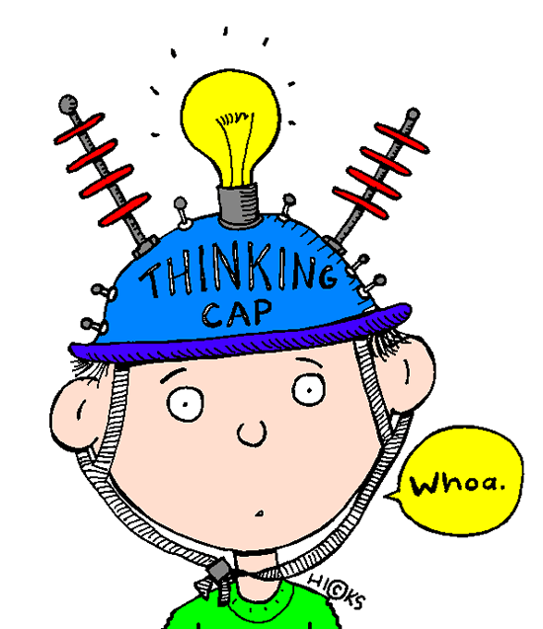
Past wisdom
Deciding which function goes to which layer is difficult!
Notes:
Có thể ví dụ về thời tiết. Dữ liệu mưa, xử lí để có tình hình thời tiết, hiển thị đồ thị.

Slide 7
3-layer model characteristics
Decoupling
Reusability
Maintainability
Can we have an example?

Slide 8
For example
1/4 + 5/4 = 24/16
Where should we put GCD?
How to minimized the fraction?
  24/16 = 3/2
What if we want mixed fraction?
  3/2 = 1 ½
How to convert back from string?

Slide 9
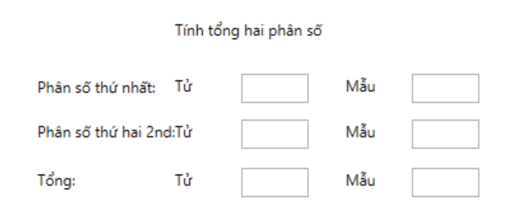
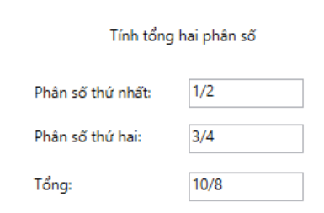
What’s more? Mapping
How about two types of UI?

Slide 10
What about Entity framework?
DTO & DAO

Slide 11
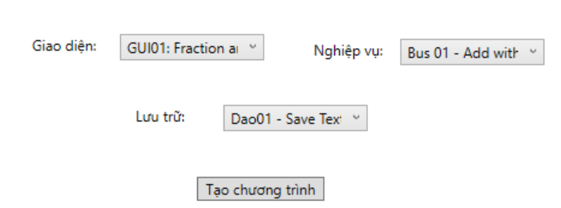
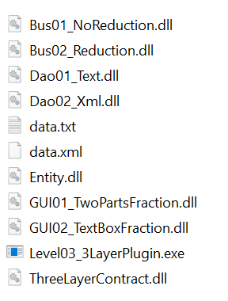
An attempt to self-implement
What we will build

Slide 12
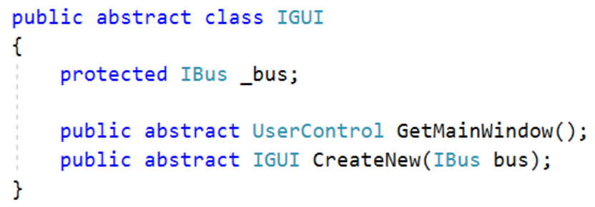
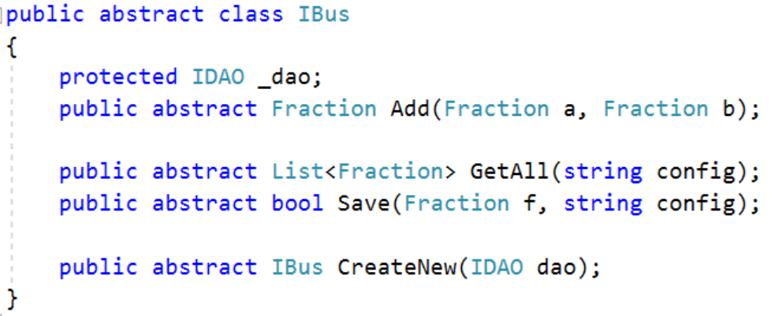
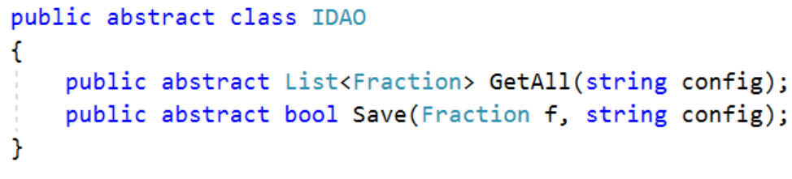
Behind the scene
Plugin architecture
Abstract factory

Slide 13
Thanks for listening

